Slide 1

For many psychiatric symptoms, there is a mild form of the same pattern of behavior that serves adaptive purposes in healthy people.
Paget Michael Creelman

Slide 2
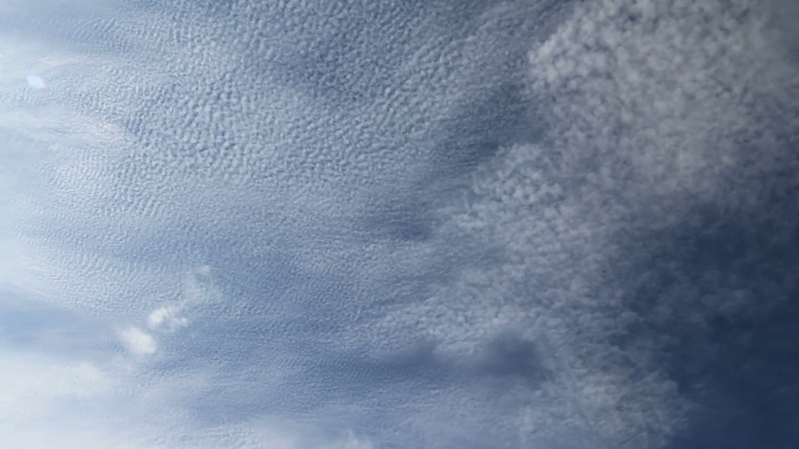

Slide 3
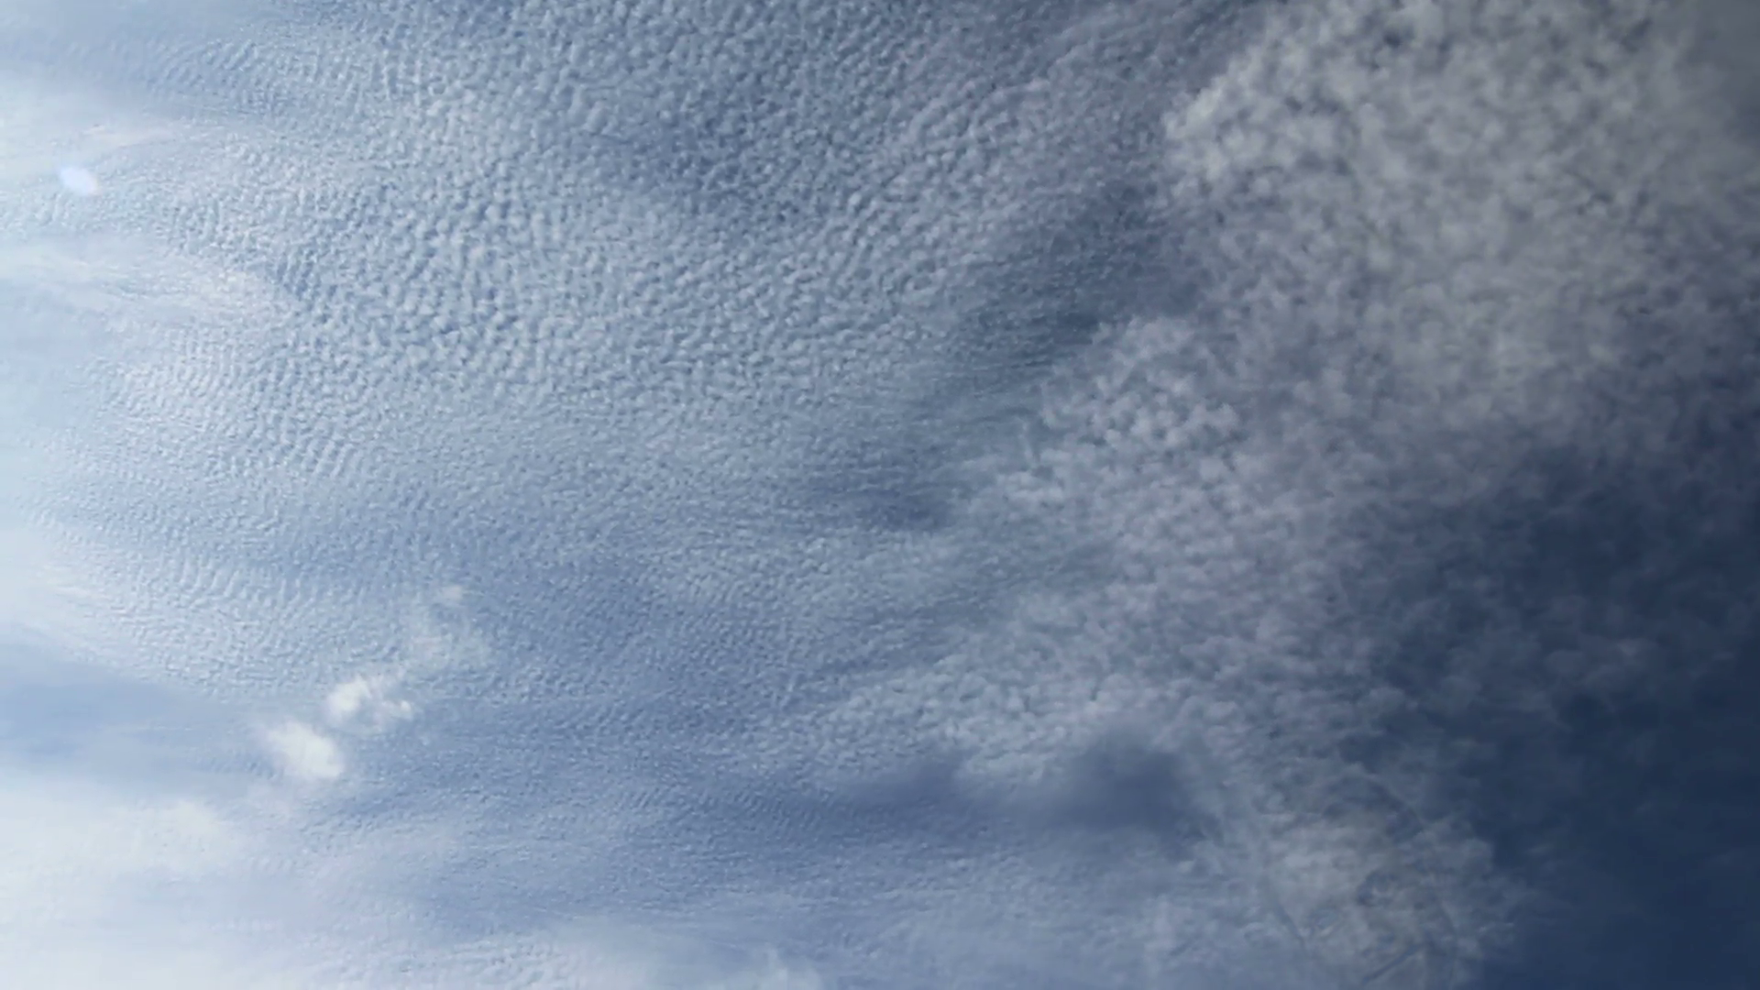

Slide 4
Do computational quantities have physiological correlates?
Do aversive vs. neutral stimuli bias behavior?
… if yes, could this potentially be used as diagnostic tool in computational psychiatry?

Slide 5
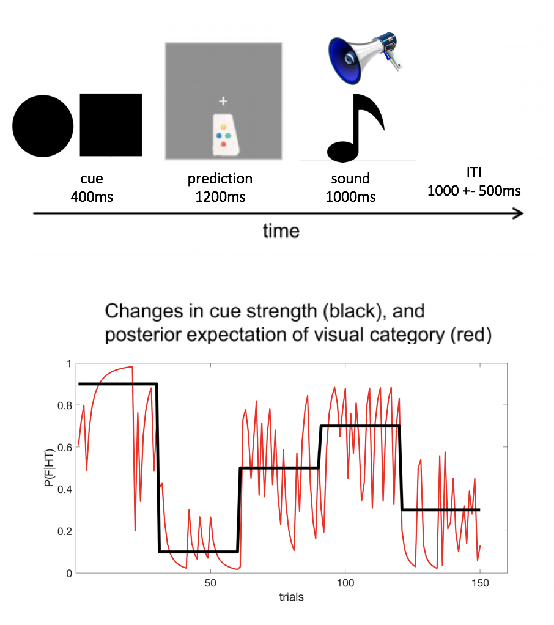
[Iglesias et al. (2013)]
Notes:
To tackle these questions, we conducted a behavioral experiment, which is not so loosely based on the hierarchical prediction error paper from 2013.
The basic procedure is identical, but we modified some things according to our needs.
In each trial of the experiment, participants saw a visual cue (a square or a circle) for 400ms and were subsequently asked to predict whether they gonna hear a sound or not. The first block consisted of 150 trials and the entire block was repeated after a short break, with the difference that the sound was designed to be aversive rather than neutral like in the first block.

Slide 6
[Iglesias et al. (2013)]
Notes:
Now importantly, the cue-stimulus-contingency changed as a function of time, or in other words the predictive power of the cue was altered every 30 trials. We were particularly interested in tracing the belief about the predictive power of the cues - and whether this belief was for example confounded by the nature of the stimulus.

Slide 7
Neutral Block
Aversive Block
//
[Iglesias et al. (2013)]
Notes:
Now importantly, the cue-stimulus-contingency changed as a function of time, or in other words the predictive power of the cue was altered every 30 trials. We were particularly interested in tracing the belief about the predictive power of the cues - and whether this belief was for example confounded by the nature of the stimulus.

Slide 8
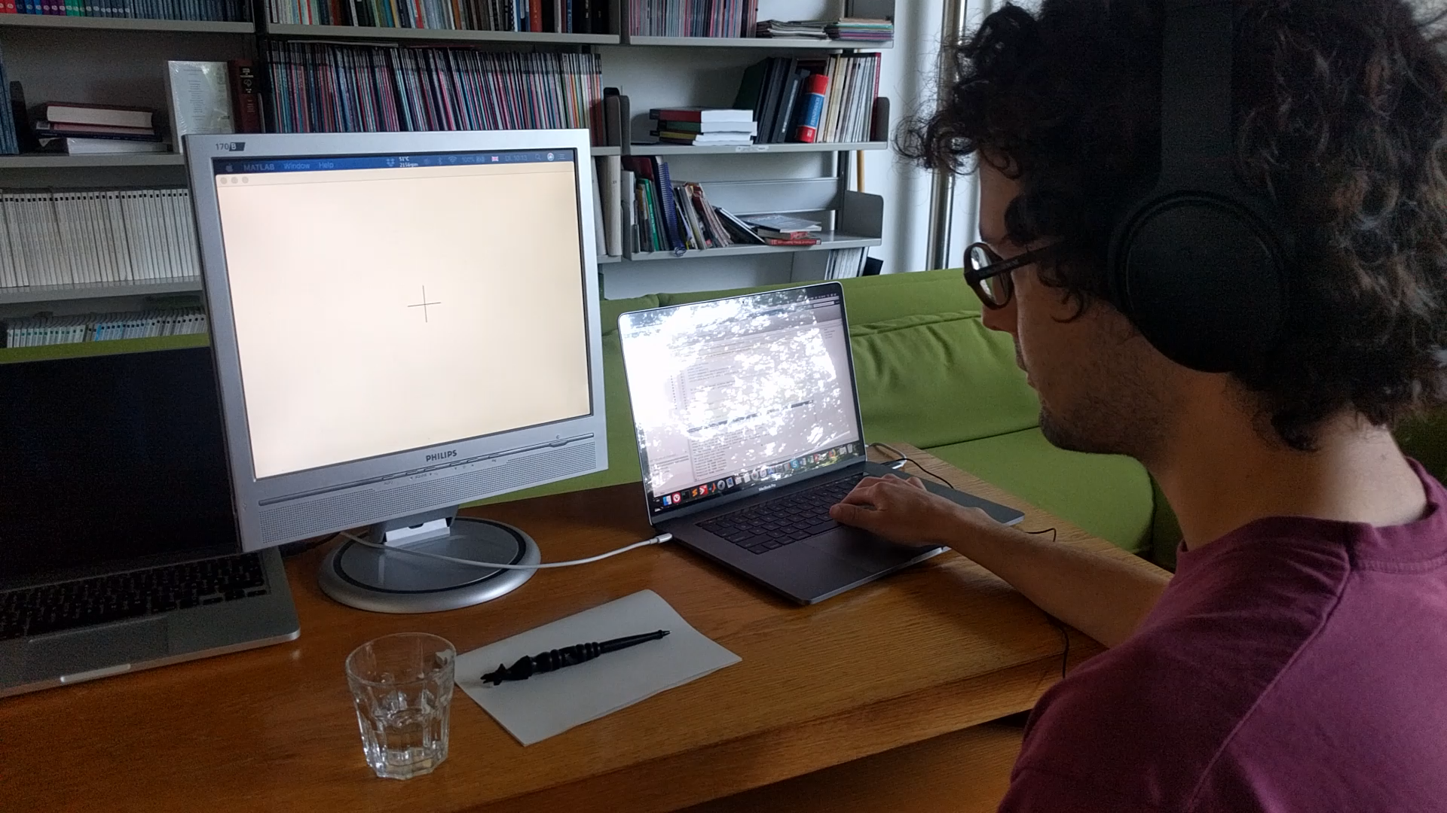
[Iglesias et al. (2013)]
Notes:
Here‘s a short video to give you an idea of how the experiment worked in practice.

Slide 9
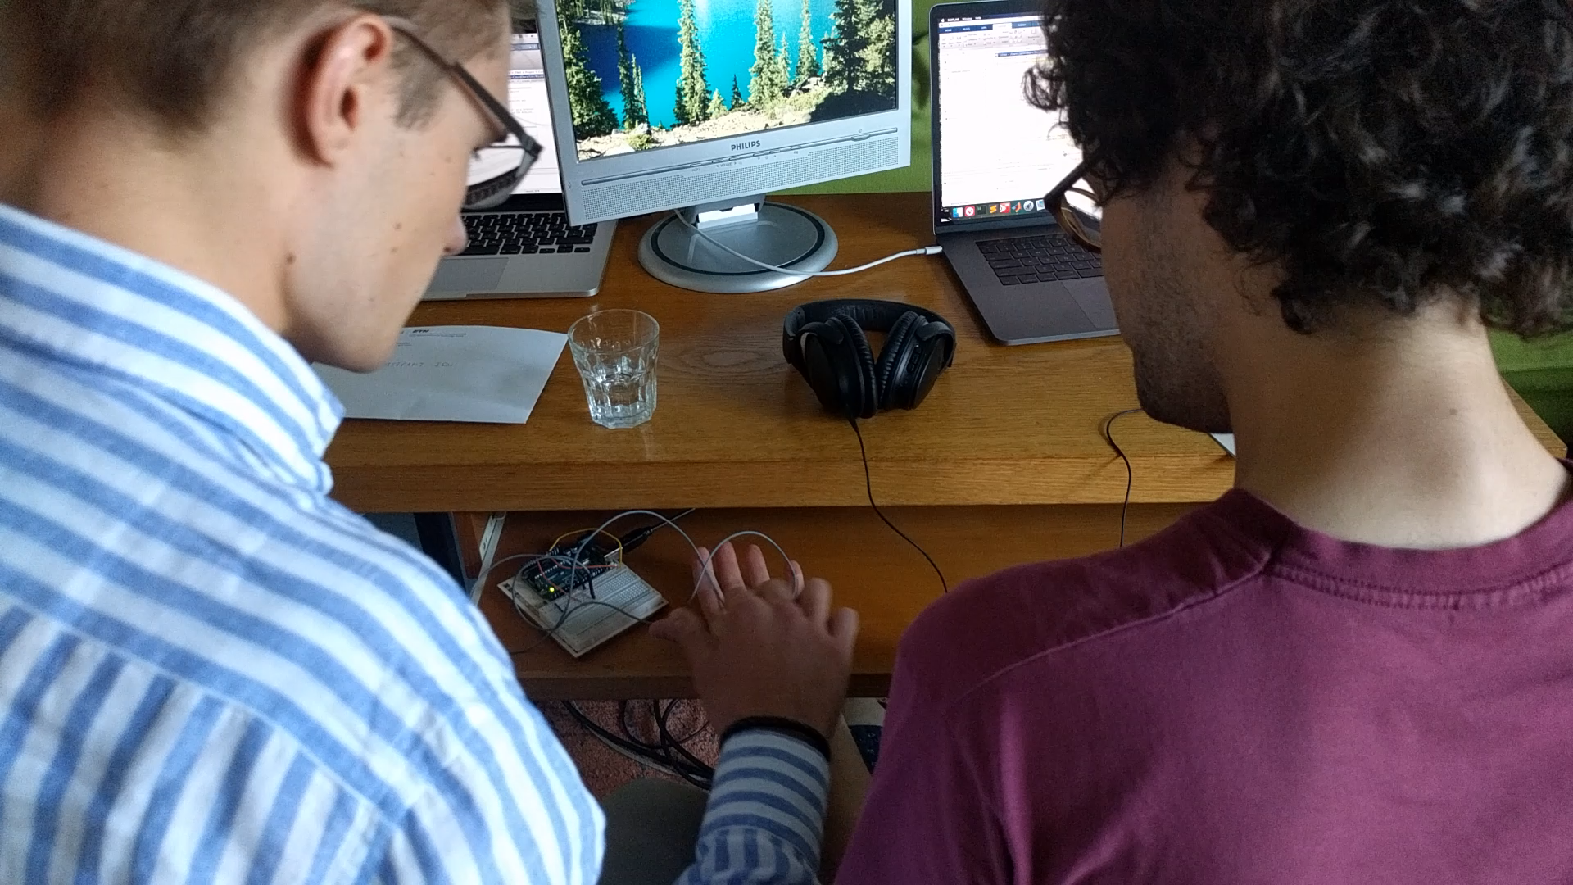
Notes:
We conducted the experiment with a cohorte of 16 subjects and besides the behavioral responses, we also collected physiological data with a hand-crafted microcontroller that measured GSR (Galvanic Skin Response).

Slide 10
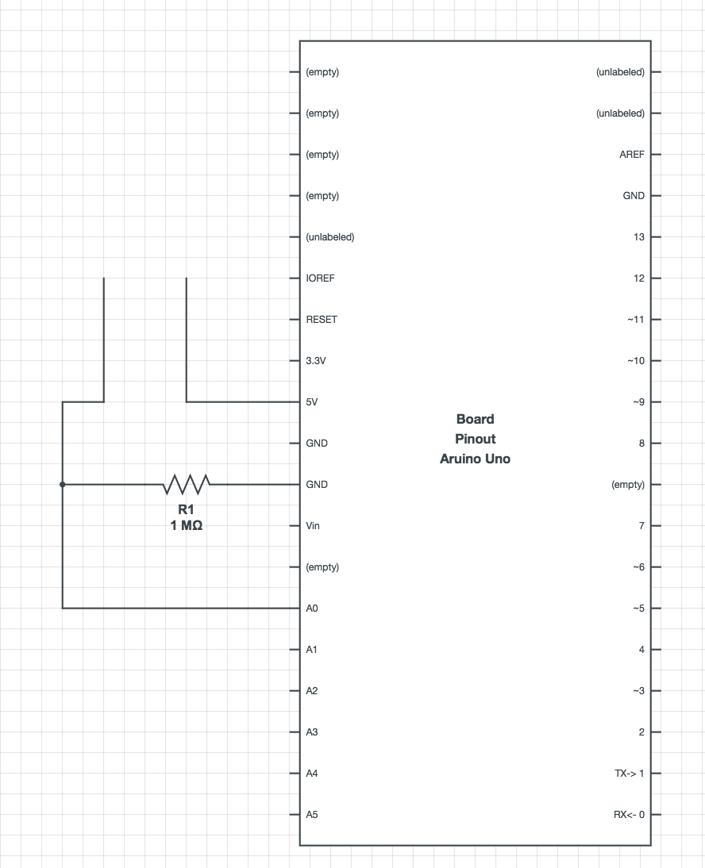
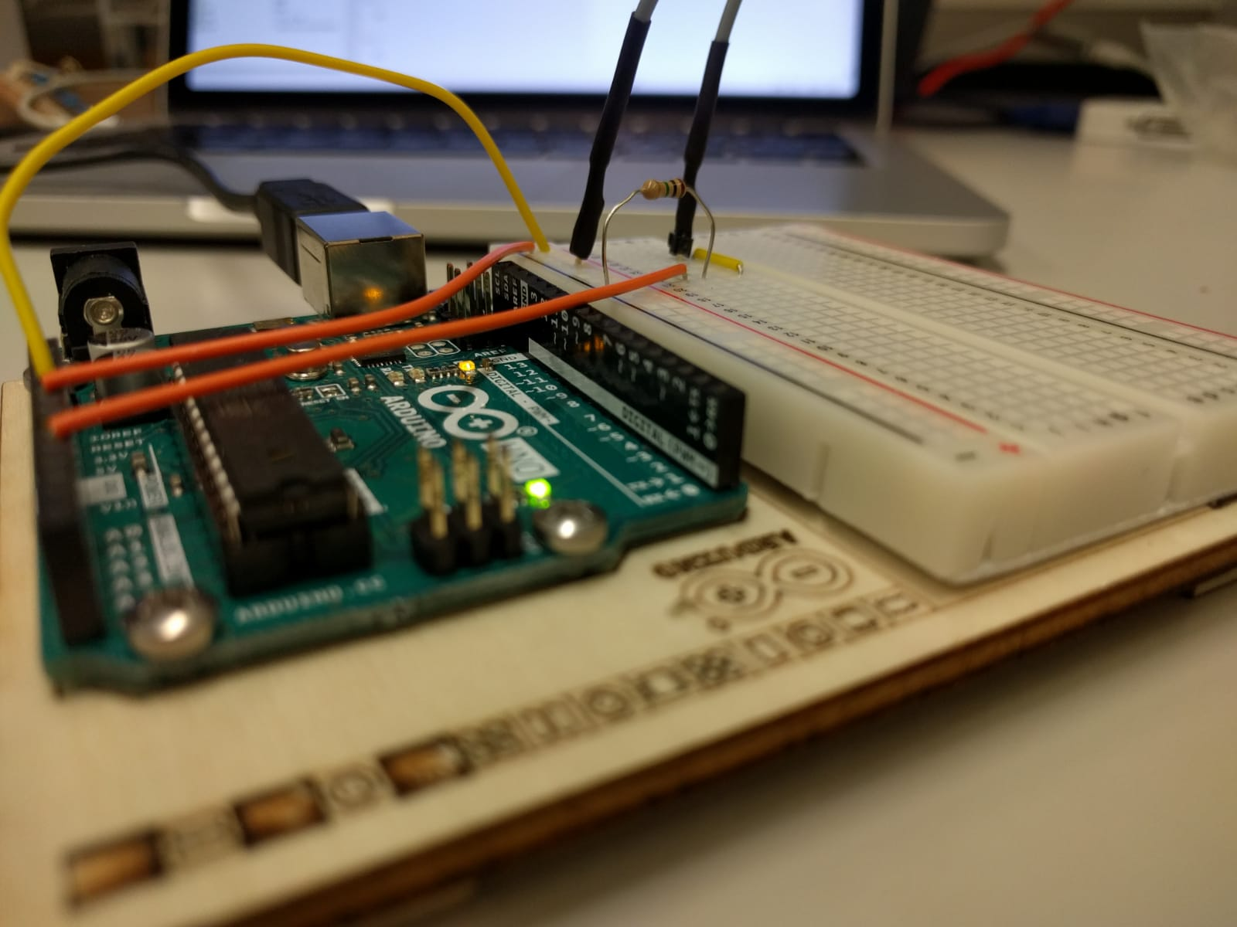
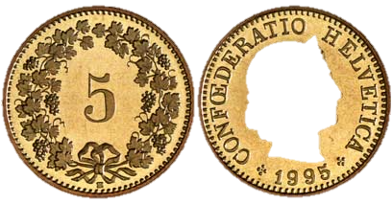
Galvanic Skin Response – handcrafted microcontroller
Notes:
So here you see the simplistic apperature we used. Basically it‘s a voltage divider measuring the conductance of the skin over the course of the experiment. Many thanks go to Jakob for providing us the electrolyte paste, that made our measurements significantly more stable.

Slide 11
Flowchart
Experiment
Subjective measures
Objective measures
Behavioral responses
Galvanic Skin Response (GSR)
Questionnaire
HGF
Alpha Model
Notes:
Here‘s a brief overview about the data we acquired and the analytical pipeline we used. In addition to a HGF based evaluation of the behavioral data we will sketch a reinterpretation of standard Bayesian regression by introducing a bias term called alpha.
But let‘s start with GSR. For those of you who don‘t know, the galvanic skin response is one of the most robust markers of emotional arousal, it is directly modulated by the activity of sweat glands. We focused our analysis on the skin conductance response, the quickly evolving, phasic component in the GSR signal, which peaks about 1-5sec post stimulus.
Had some teething troubles with the GSR recording which forced us to discard all but the last 4 subjects we recorded.
We compared many different quantities, for example the mean stimulus specific response to the neutral vs the aversive sound, none of them were tremendously meaningful.

Slide 12
A prediction error signal in the Skin Conductance Response?
Notes:
As Moritz said, we raised the question whether there is any prediction error related signal in the data

Slide 13
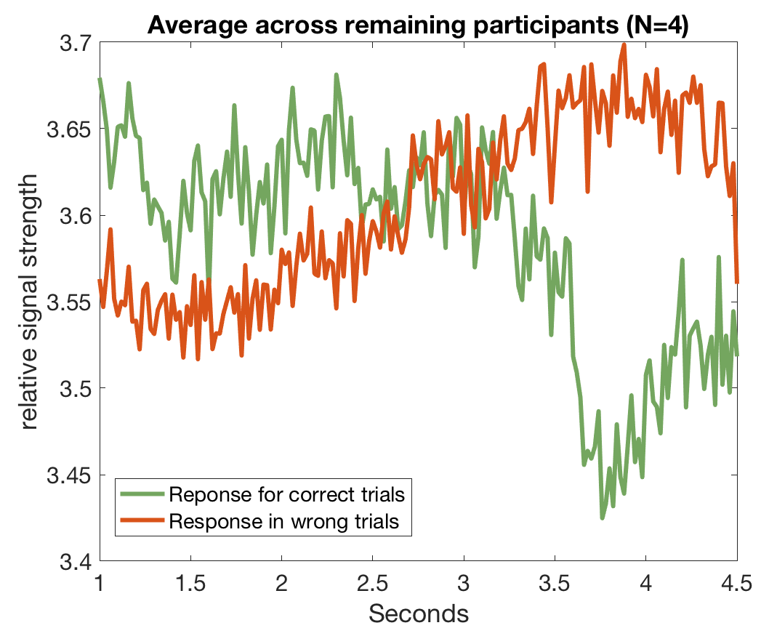
A prediction error signal in the Skin Conductance Response?
Notes:
Averaged across participants, you see here the mean response for correct vs wrong trials. We can see a medioker tendency of increased response for the wrong trials. In the correct trials, there is some drop around 3.5sec post-stimulus.
This is far from being significant, but it gives us a direction to work towards.

Slide 14
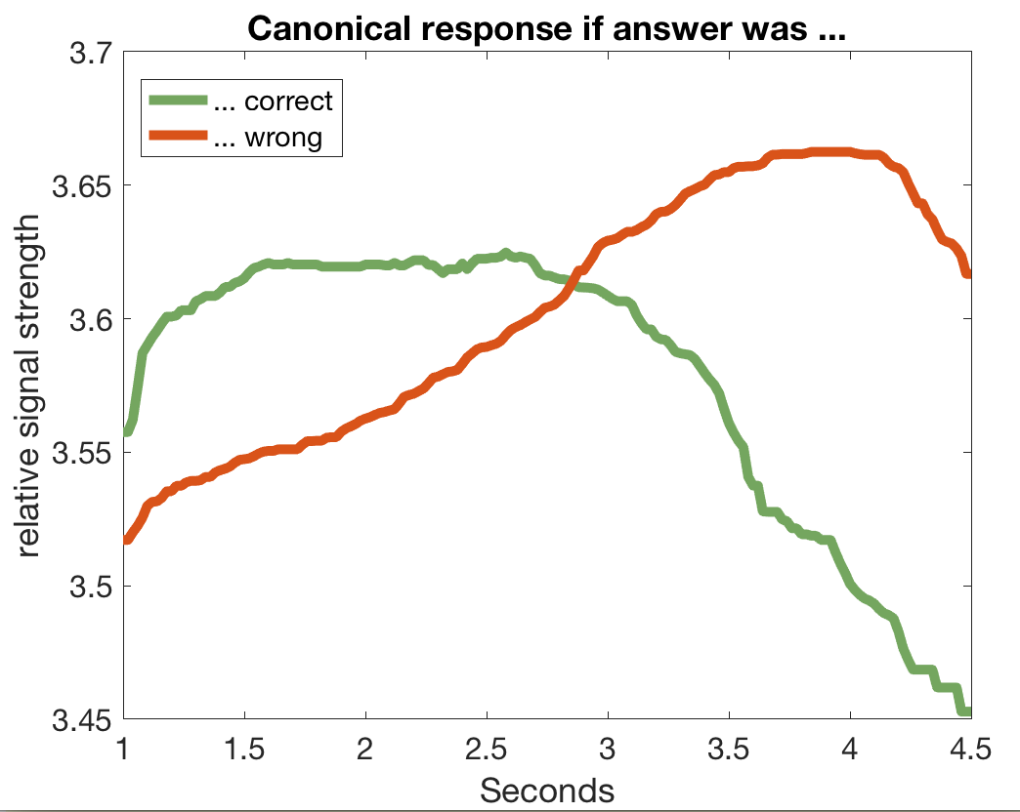
A prediction error signal in the Skin Conductance Response?
filtering
Notes:
We can now filter these curves to get the canonical responses for correct and wrong trials.
Now, in principle we have a method to trace back the belief about the occurrence of the sound for every trial. For example, if a trial has a response very similar to the canonical prediction error response, we could infer that the participant had a wrong belief for that particular trial. In other words, we could generate a trace of binary responses – even without having recorded behavioral data.
Our plan is to feed this gsr based prediction trace into the binary HGF and compare it to the HGF fits we obtained from the behavioral data. The details will be in the report, but the question we‘re raising is whether the beliefs could be inferred even in the absence of a behavioral response?
Correlated with PE traces from the HGFs but didn‘t go above 0.2

Slide 15
Flowchart
Experiment
Subjective measures
Objective measures
Behavioral responses
Galvanic Skin Response (GSR)
Questionnaire
HGF
Alpha Model

Slide 16
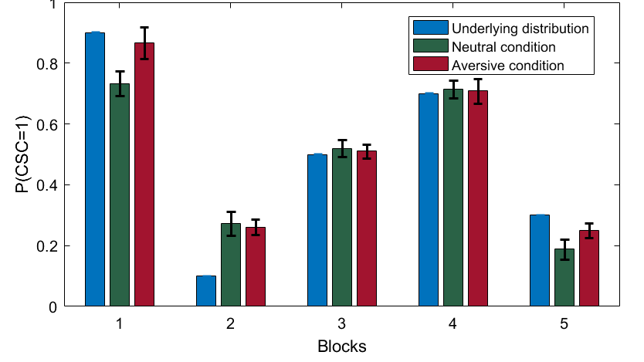
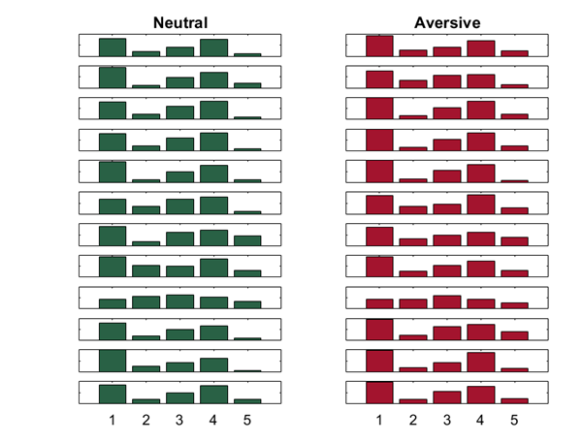
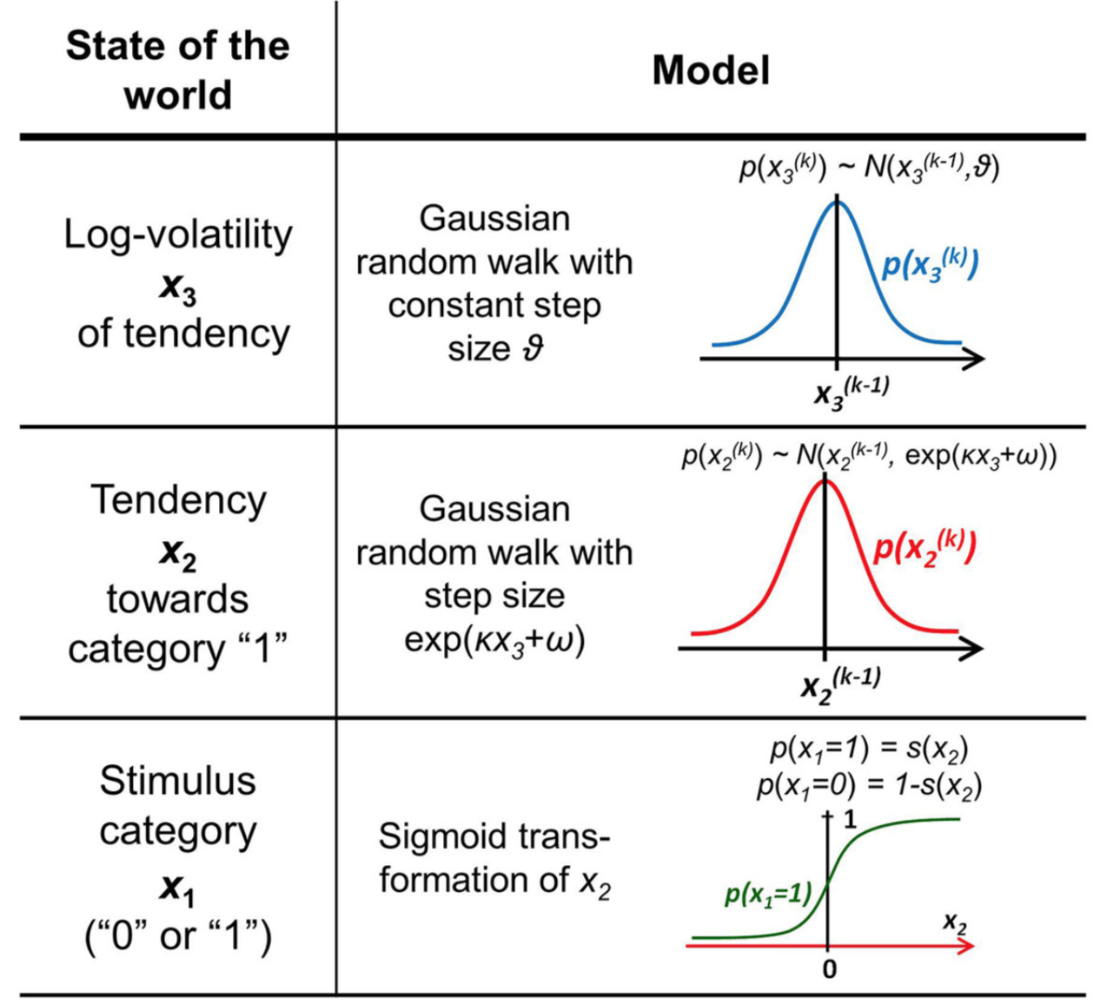
Performance assessment
Average responses
Individual responses
Individual differences
Mechanisms
HGF

Slide 17
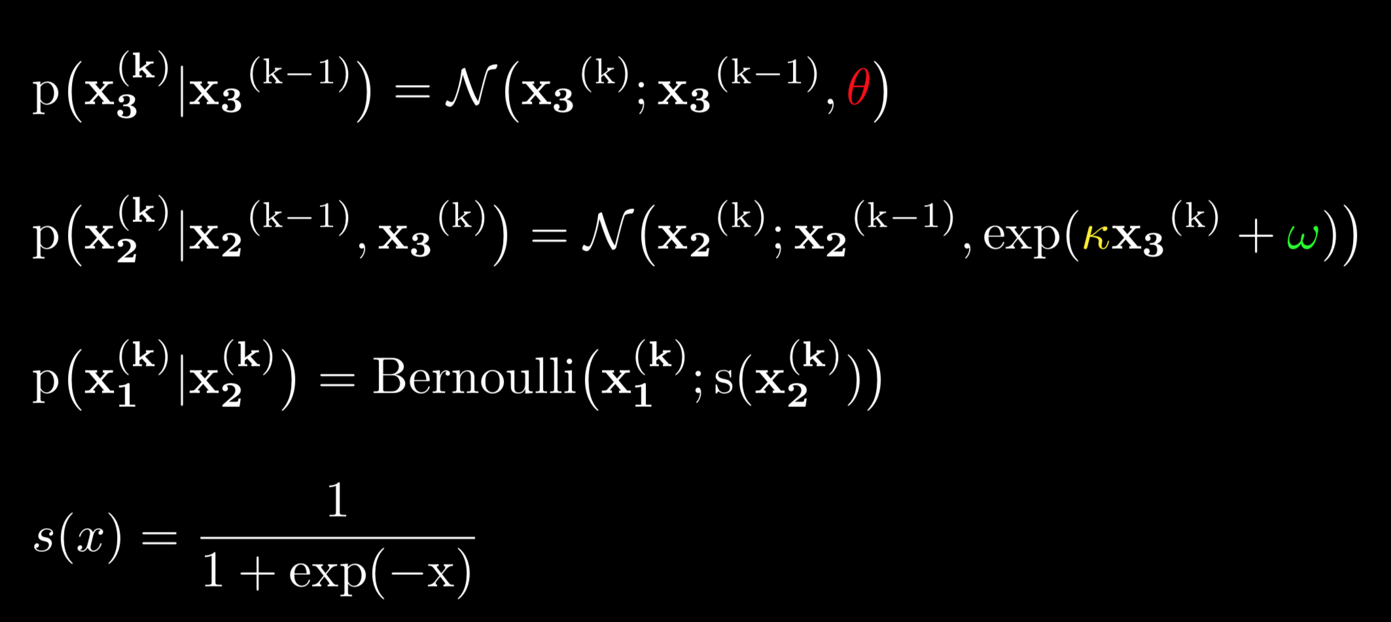
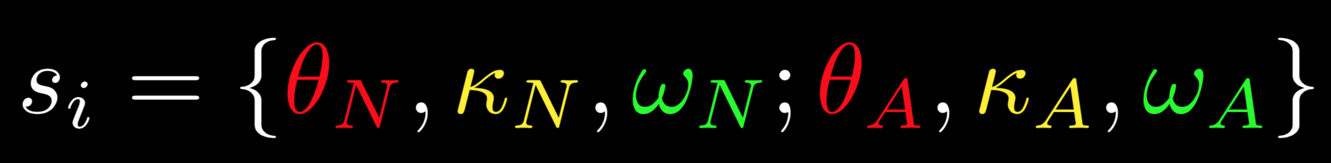
The HGF – A generative model of behavior
variance of volatility
phasic
tonic
For every subject $s_{i}∈S$, we fit an HGF and obtain parameter sets for neutral and aversive blocks.

Slide 18
The HGF – A generative model of behavior
STIMULUS CATEGORY and TENDENCY to be read in cue-stimulus-contingency terms:
1 is defined as square → tone or circle → no tone
0 is defined as square → no tone or circle → tone
To what degree do aversive vs. neutral stimuli bias behavior?
Fit HGFs for both neutral and aversive blocks for all subjects and compare parameters.
Notes:
Now we want to fit the HGFs for both neutral and aversive blocks and compare parameters to answer: …

Slide 19
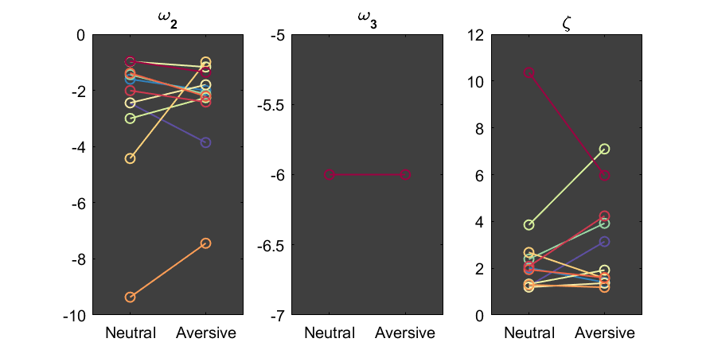
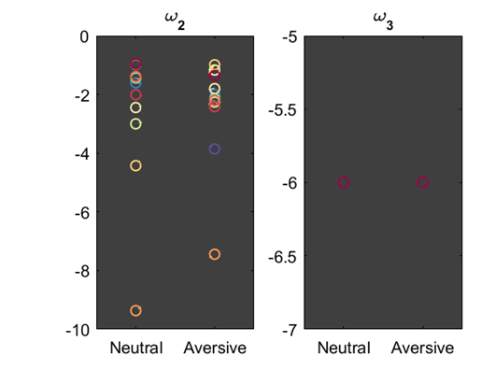
HGF fit
To what degree do aversive vs. neutral stimuli bias behavior?
3-layer HGF
Parameter distribution
Directional changes in variance of the tendency?

Slide 20
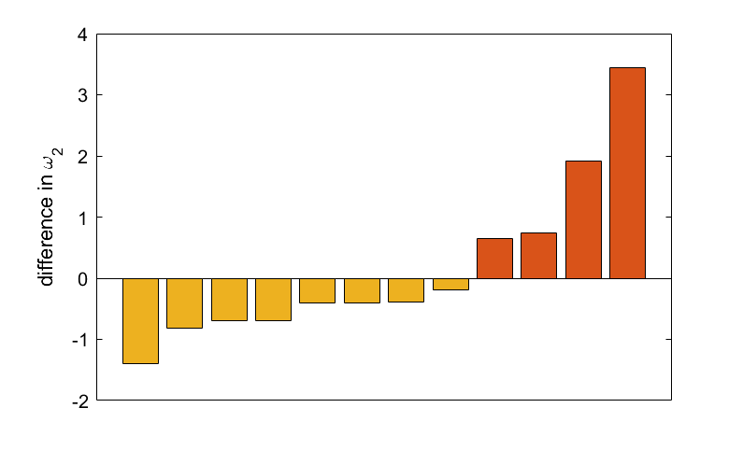
HGF fit
To what degree do aversive vs. neutral stimuli bias behavior?
An interpretation
Parameter distribution
higher variance in
aversive condition
lower variance in
aversive condition
Directional changes in variance of the tendency?

Slide 21
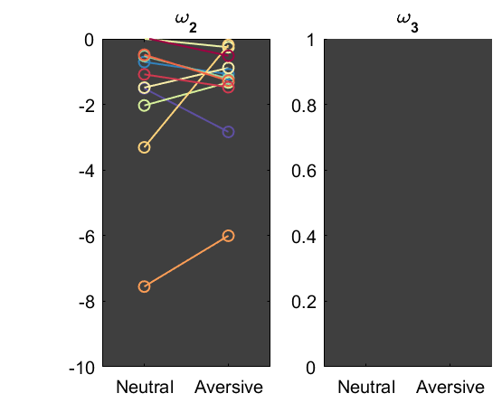
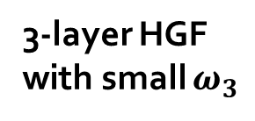
HGF comparison
3-layer HGF with small $ω_{3}$
2-layer HGF
(see report)

Slide 22
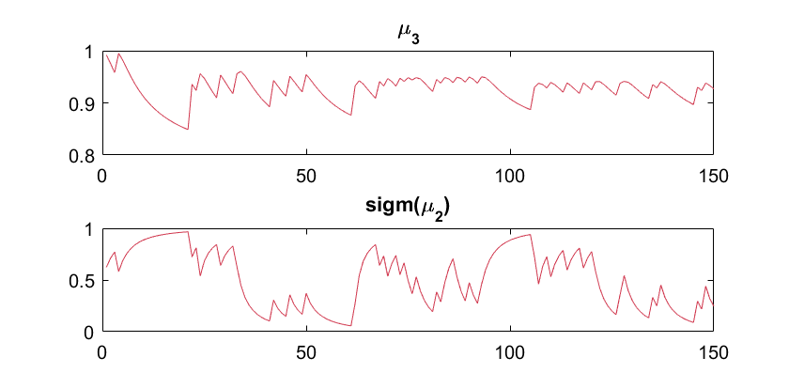
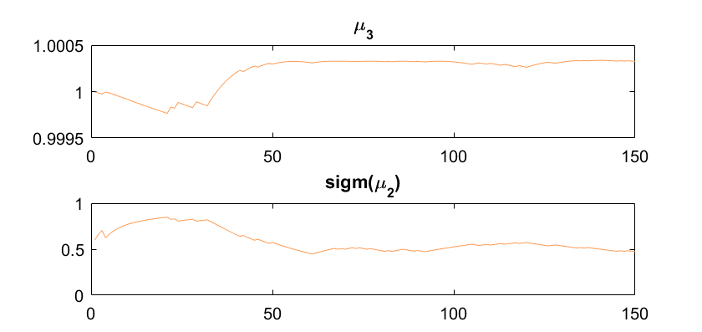
On temporal dynamics
Observation:
The curves show a clear difference in smoothness.
The Engineer‘s perspective: = filtering over more/less samples? = applying different temporal kernels?
Can we assess predictive processes in terms of temporal windows of integration?

Slide 23
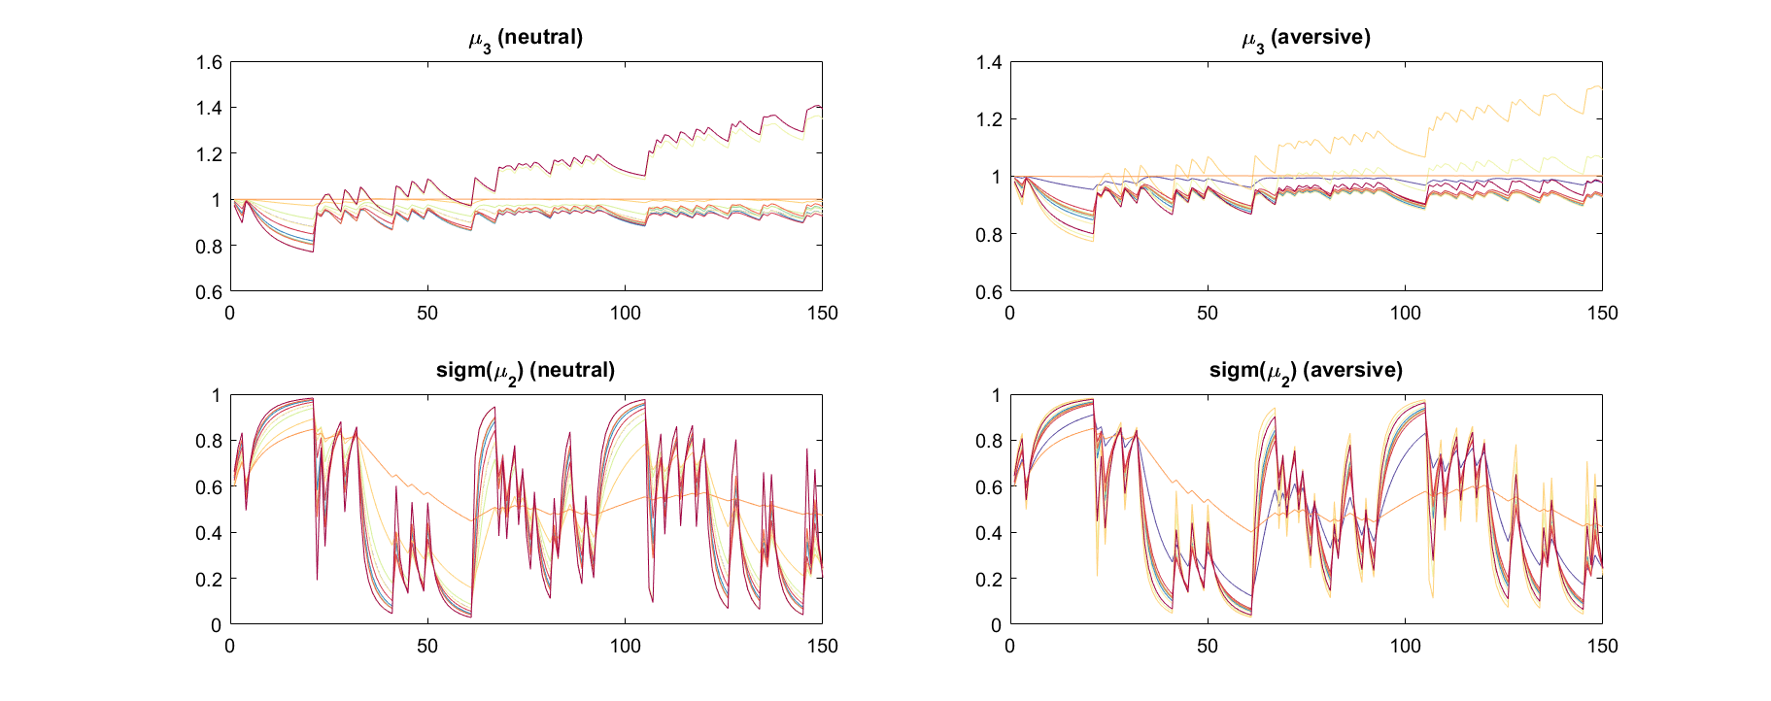

Slide 24
Flowchart
Experiment
Subjective measures
Objective measures
Behavioral responses
Galvanic Skin Response (GSR)
Questionnaire
HGF
Alpha Model

Slide 25
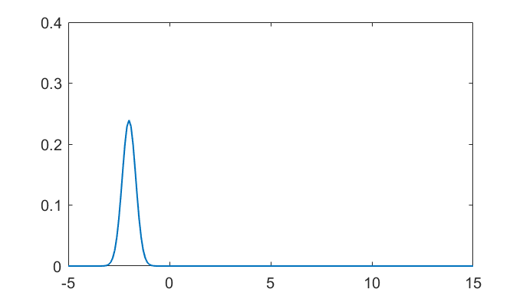
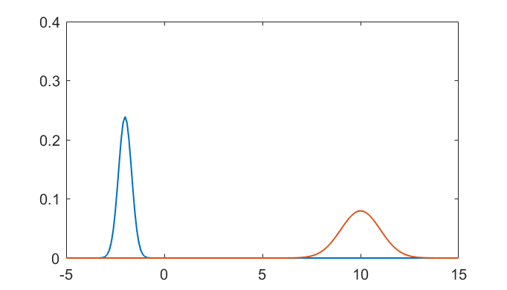
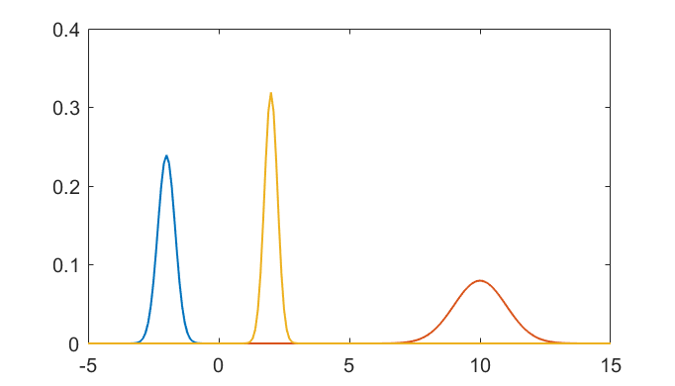
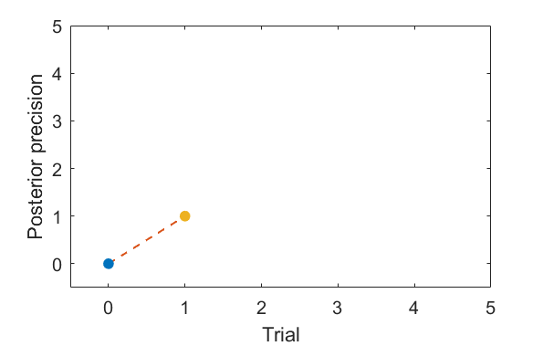
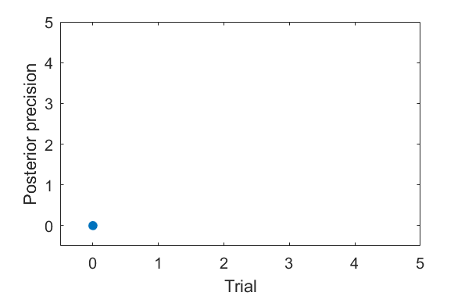
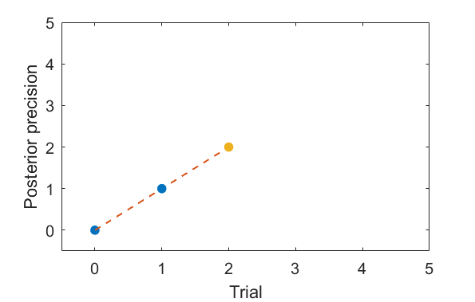
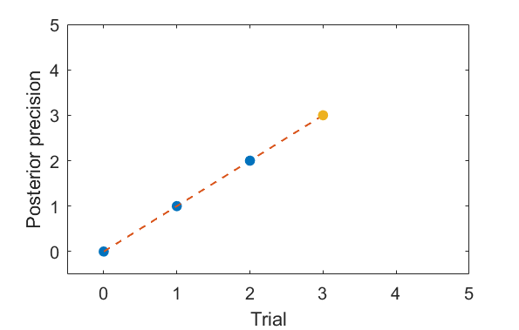
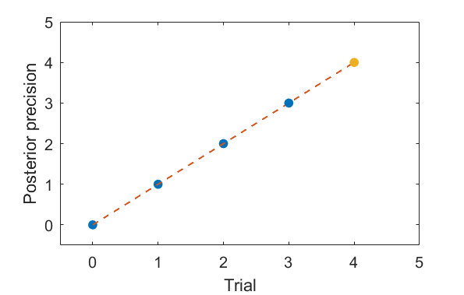
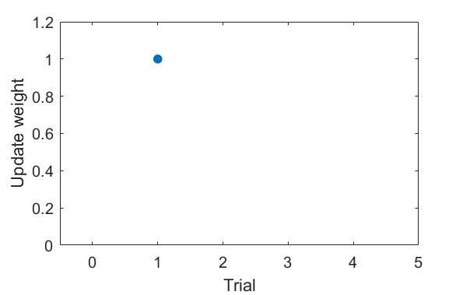
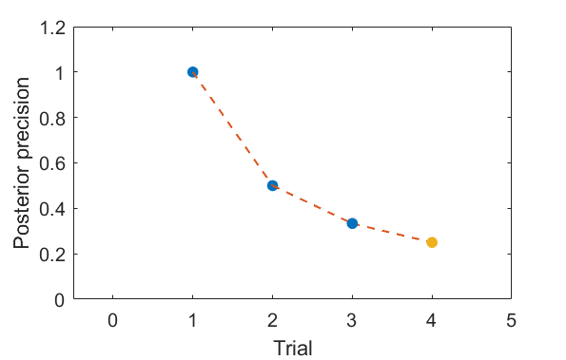
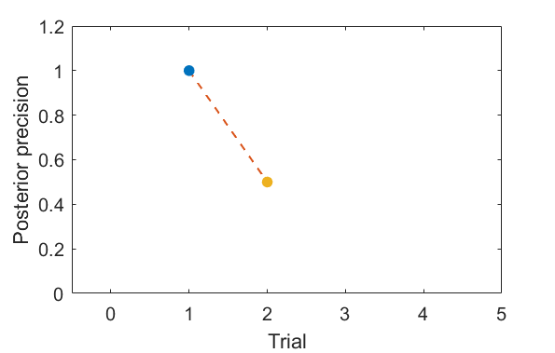
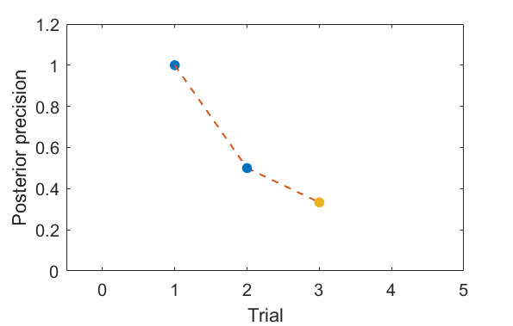
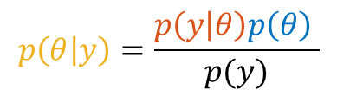

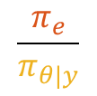
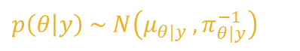

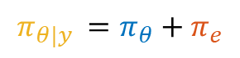
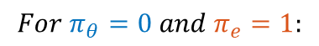
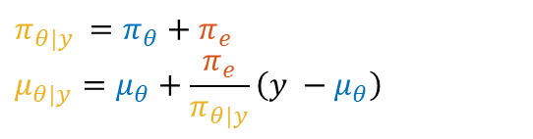

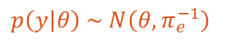

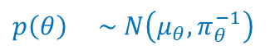
A Pseudo-Bayesian approach
Bayes‘ Theorem
Example: Gaussians
Sequential update equations
$$p\left(θ\right) \sim N\left(μ_{θ}, π_{θ}^{−1}\right)$$
$$π_{θ|y }=π_{θ}+π_{e}$$
$$μ_{θ|y}=μ_{θ}+\frac{π_{e}}{π_{θ|y}}\left(y −μ_{θ}\right)$$
$$p\left(θ | y\right)=\frac{p\left(y | θ\right)p\left(θ\right) }{p(y)}$$
$$p\left(y | θ\right) \sim N\left(θ, π_{e}^{−1}\right)$$
$$p\left(θ | y\right) \sim N\left(μ_{θ|y }, π_{θ|y}^{−1}\right)$$
$$For π_{θ}=0 and π_{e}=1:$$
$$Posterior$$
Posterior precision:
$$π_{θ|y }=π_{θ}+π_{e}$$
$$Prior$$
P$osterior∝Likelihood ∗Prior$
Precision ratio:
$$Likelihood$$
$$\frac{π_{e}}{π_{θ|y}}$$

Slide 26
A Pseudo-Bayesian approach
Bayes‘ Theorem
Example: Gaussians
Sequential update equations
$$p\left(θ\right) \sim N\left(μ_{θ}, π_{θ}^{−1}\right)$$
$$π_{θ|y }=π_{θ}+π_{e}$$
$$μ_{θ|y}=μ_{θ}+\frac{π_{e}}{π_{θ|y}}\left(y −μ_{θ}\right)$$
$$p\left(θ | y\right)=\frac{p\left(y | θ\right)p\left(θ\right) }{p(y)}$$
$$p\left(y | θ\right) \sim N\left(θ, π_{e}^{−1}\right)$$
$$p\left(θ | y\right) \sim N\left(μ_{θ|y }, π_{θ|y}^{−1}\right)$$
$$For π_{θ}=0 and π_{e}=1:$$
Posterior precision:
$$π_{θ|y }=π_{θ}+π_{e}$$
Intuition: After having seen three trials, the fourth input will be weighted by ¼.
uniform trial weighting
→ (non-hierarchical) Bayes-optimality
Precision ratio:
$$\frac{π_{e}}{π_{θ|y}}$$

Slide 27
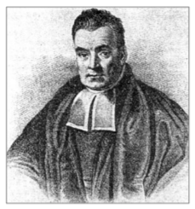
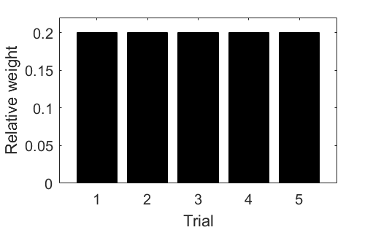
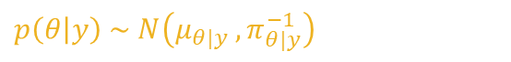
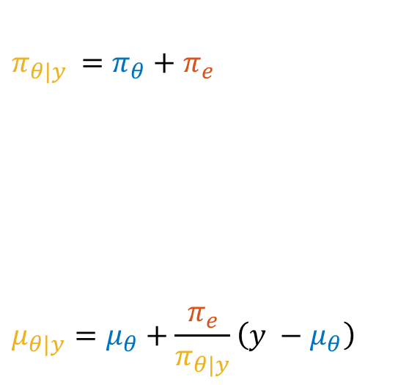
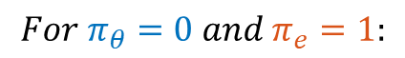
Towards a Pseudo-Bayesian model
$$For π_{θ}=0 and π_{e}=1:$$
Sequential update equations:
$$p\left(θ | y\right) \sim N\left(μ_{θ|y }, π_{θ|y}^{−1}\right)$$
$$π_{θ|y }=π_{θ}+π_{e}$$
$$μ_{θ|y}=μ_{θ}+\frac{π_{e}}{π_{θ|y}}\left(y −μ_{θ}\right)$$
Importance of 4th trial = ¼ (not more, not less)
all trials will be taken into account equally.
Non-hierarchical Bayes-optimality
… so that at the 11th trial, you will wait the prediction error by 1/11 (assuming no prior).
Essentially finds the mean of all observations (priors as pseudodata)

Slide 28
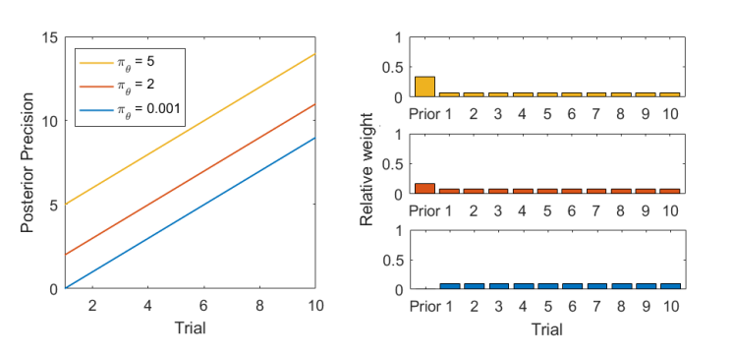
Notes:
also the prior cannot change this; it can only change this; not the relative thing.

Slide 29
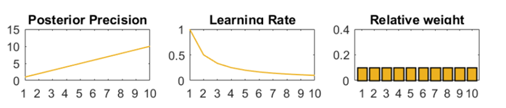







A Pseudo-Bayesian approach
Bayes-optimal:
$$π_{θ|x }=π_{θ}+π_{e}$$
$$μ_{θ|x}=μ_{θ}+\frac{π_{e}}{π_{θ|x}}\left(x −μ_{θ}\right)$$
A Pseudo-Bayes Model:
$$π_{θ|x }=π_{θ}+α ∗π_{e}$$
$$μ_{θ|x}=μ_{θ}+\frac{π_{e}}{π_{θ|x}}\left(x −μ_{θ}\right)$$
$$α=0.1$$
$$α=0.5$$
$$α=1$$
… can we fit subject-specific alphas?
$$α=2$$

Slide 30



Goal: Find the optimal $α$ for the forward model
Forward Model:
$π_{θ|x}=π_{θ}+α π_{e}$
$μ_{θ|y }=μ_{θ}+\frac{π_{e}}{π_{θ|x}}\left(x_{k}−μ_{θ}\right)$
$\hat{y}=s(μ_{θ|y})$
Error Function: $e=\left(y−\hat{y}\right)$
$\min\left(e^{T}e\right)=\min\left[{\left(y−s\left(μ\right)\right)}^{T}\left(y−s\left(μ\right)\right)\right]$
Notes:
Crucial questions for generative models, how to find the hyperparameter that best explain our data?
Since the Model is driven by alpha rather than the priors (precision and belief (blue)), we focus on the alpha, which is usually in the range of [0.1,2]. At 1 the model collapses to regular bayes rule update equations.
Here is the forward model again. The third step is optional. Just a very step sigmoid transforming a continuous belief in an almost binary output. In our case necessary as we fitted a binary response (sound, no sound), but if we would fit a continuous belief (e.g. the belief about the tendency of cue stimulus contingencey which comes as mu2 out of the HGF) we can ommit that step.
Goal is to minimize the sum of squared distances.

Slide 31

Goal: Find the optimal $α$ for the forward model
Forward Model:
$π_{θ|x}=π_{θ}+α π_{e}$
$μ_{θ|y }=μ_{θ}+\frac{π_{e}}{π_{θ|x}}\left(x_{k}−μ_{θ}\right)$
$\hat{y}=s(μ_{θ|y})$
Error Function: $e=\left(y−\hat{y}\right)$
$\min\left(e^{T}e\right)=\min\left[{\left(y−s\left(μ\right)\right)}^{T}\left(y−s\left(μ\right)\right)\right]$
$$\frac{∂e^{T}e}{∂α} =\frac{∂}{∂α}\left[y^{T}y −y^{T}s\left(μ\left(α\right)\right)−s{\left(μ\left(α\right)\right)}^{T}y+s{\left(μ\left(α\right)\right)}^{T}s\left(μ\left(α\right)\right)\right]$$
Notes:
Minimize quadratic error. Partial derivative: Change in posterior precision, ommitted theta and x for clarity

Slide 32

Goal: Find the optimal $α$ for the forward model
Forward Model:
$π_{θ|x}=π_{θ}+α π_{e}$
$μ_{θ|y }=μ_{θ}+\frac{π_{e}}{π_{θ|x}}\left(x_{k}−μ_{θ}\right)$
$\hat{y}=s(μ_{θ|y})$
Error Function: $e=\left(y−\hat{y}\right)$
$\min\left(e^{T}e\right)=\min\left[{\left(y−s\left(μ\right)\right)}^{T}\left(y−s\left(μ\right)\right)\right]$
$$\frac{∂e^{T}e}{∂α} =\frac{∂}{∂α}\left[y^{T}y −y^{T}s\left(μ\left(α\right)\right)−s{\left(μ\left(α\right)\right)}^{T}y+s{\left(μ\left(α\right)\right)}^{T}s\left(μ\left(α\right)\right)\right]$$
$=−2\frac{∂s{\left(μ\left(α\right)\right)}^{T}}{∂α} y+2\frac{∂s({μ(α))}^{T}}{∂α} s(μ\left(α\right))$
$$=−2{\left[\frac{∂s{\left(μ\left(α\right)\right)}^{ }}{∂\left(μ\left(α\right)\right)}\frac{∂μ\left(α\right)}{∂α}\right]}^{T}y+2{\left[\frac{∂s{\left(μ\left(α\right)\right)}^{ }}{∂\left(μ\left(α\right)\right)}\frac{∂μ\left(α\right)}{∂α}\right]}^{T}s(μ\left(α\right))$$
Notes:
Looks quite tedious. Unfortunately, the mus are vectors that are updated iteratively. With our vague math skills we were unable to find a closed form analytical expression, if there exists any. We thus decided to massage this beast by computing the partial derivatives iteratively as time progresses. We know that‘s not pretty, if you have any thoughts on this we‘d be happy to hear it.

Slide 33

Goal: Find the optimal $α$ for the forward model
Forward Model:
$π_{θ|x}=π_{θ}+α π_{e}$
$μ_{θ|y }=μ_{θ}+\frac{π_{e}}{π_{θ|x}}\left(x_{k}−μ_{θ}\right)$
$\hat{y}=s(μ_{θ|y})$
Error Function: $e=\left(y−\hat{y}\right)$
$\min\left(e^{T}e\right)=\min\left[{\left(y−s\left(μ\right)\right)}^{T}\left(y−s\left(μ\right)\right)\right]$
$$\frac{∂e^{T}e}{∂α} =\frac{∂}{∂α}\left[y^{T}y −y^{T}s\left(μ\left(α\right)\right)−s{\left(μ\left(α\right)\right)}^{T}y+s{\left(μ\left(α\right)\right)}^{T}s\left(μ\left(α\right)\right)\right]$$
$=−2\frac{∂s{\left(μ\left(α\right)\right)}^{T}}{∂α} y+2\frac{∂s({μ(α))}^{T}}{∂α} s(μ\left(α\right))$
$$=−2{\left[\frac{∂s{\left(μ\left(α\right)\right)}^{ }}{∂\left(μ\left(α\right)\right)}\frac{∂μ\left(α\right)}{∂α}\right]}^{T}y+2{\left[\frac{∂s{\left(μ\left(α\right)\right)}^{ }}{∂\left(μ\left(α\right)\right)}\frac{∂μ\left(α\right)}{∂α}\right]}^{T}s(μ\left(α\right))$$
Compute partial derivatives iteratively, e.g. at time $t$:
$\frac{∂μ_{t}(α)}{∂α}=\frac{∂μ_{t−1}(α)}{∂α}−\frac{∂π_{t}\left(α\right)}{∂α}. \frac{π_{e}\left(x_{t}−μ_{t−1}\right)}{π_{t}^{2}}−\frac{∂μ_{t−1}\left(α\right)}{∂α}\frac{π_{e}}{π_{t}}$

Slide 34

Goal: Find the optimal $α$ for the forward model
Forward Model:
$π_{θ|x}=π_{θ}+α π_{e}$
$μ_{θ|y }=μ_{θ}+\frac{π_{e}}{π_{θ|x}}\left(x_{k}−μ_{θ}\right)$
$\hat{y}=s(μ_{θ|y})$
Error Function: $e=\left(y−\hat{y}\right)$
$\min\left(e^{T}e\right)=\min\left[{\left(y−s\left(μ\right)\right)}^{T}\left(y−s\left(μ\right)\right)\right]$
$$\frac{∂e^{T}e}{∂α} =\frac{∂}{∂α}\left[y^{T}y −y^{T}s\left(μ\left(α\right)\right)−s{\left(μ\left(α\right)\right)}^{T}y+s{\left(μ\left(α\right)\right)}^{T}s\left(μ\left(α\right)\right)\right]$$
$=−2\frac{∂s{\left(μ\left(α\right)\right)}^{T}}{∂α} y+2\frac{∂s({μ(α))}^{T}}{∂α} s(μ\left(α\right))$
$$=−2{\left[\frac{∂s{\left(μ\left(α\right)\right)}^{ }}{∂\left(μ\left(α\right)\right)}\frac{∂μ\left(α\right)}{∂α}\right]}^{T}y+2{\left[\frac{∂s{\left(μ\left(α\right)\right)}^{ }}{∂\left(μ\left(α\right)\right)}\frac{∂μ\left(α\right)}{∂α}\right]}^{T}s(μ\left(α\right))$$
Compute partial derivatives iteratively, e.g. at time $t$:
$\frac{∂μ_{t}(α)}{∂α}=\frac{∂μ_{t−1}(α)}{∂α}−\frac{∂π_{t}\left(α\right)}{∂α}. \frac{π_{e}\left(x_{t}−μ_{t−1}\right)}{π_{t}^{2}}−\frac{∂μ_{t−1}\left(α\right)}{∂α}\frac{π_{e}}{π_{t}}$
with $\frac{∂μ_{1}(α)}{∂α}=−\frac{π_{e}^{2}}{π_{θ}^{2}}⋅\left(x_{1}−μ_{θ}\right)$ and $\frac{∂π_{t}\left(α\right)}{∂α}=t⋅π_{e}$
Notes:
Of course, this method comes with all the drawbacks that local optimization techniques have w.r.t. non-convex error surfaces.
Here is an example of one of one of our participants we fitted. Clearly alpha plays the dominant role for the fit compared to the prior precision.
Used this technique to fit the binary responses of the participants as well as imitating the HGF belief trajectory (

Slide 35


Goal: Find the optimal $α$ for the forward model
Forward Model:
$π_{θ|x}=π_{θ}+α π_{e}$
$μ_{θ|y }=μ_{θ}+\frac{π_{e}}{π_{θ|x}}\left(x_{k}−μ_{θ}\right)$
$\hat{y}=s(μ_{θ|y})$
Error Function: $e=\left(y−\hat{y}\right)$
$\min\left(e^{T}e\right)=\min\left[{\left(y−s\left(μ\right)\right)}^{T}\left(y−s\left(μ\right)\right)\right]$
$$\frac{∂e^{T}e}{∂α} =\frac{∂}{∂α}\left[y^{T}y −y^{T}s\left(μ\left(α\right)\right)−s{\left(μ\left(α\right)\right)}^{T}y+s{\left(μ\left(α\right)\right)}^{T}s\left(μ\left(α\right)\right)\right]$$
$=−2\frac{∂s{\left(μ\left(α\right)\right)}^{T}}{∂α} y+2\frac{∂s({μ(α))}^{T}}{∂α} s(μ\left(α\right))$
$$=−2{\left[\frac{∂s{\left(μ\left(α\right)\right)}^{ }}{∂\left(μ\left(α\right)\right)}\frac{∂μ\left(α\right)}{∂α}\right]}^{T}y+2{\left[\frac{∂s{\left(μ\left(α\right)\right)}^{ }}{∂\left(μ\left(α\right)\right)}\frac{∂μ\left(α\right)}{∂α}\right]}^{T}s(μ\left(α\right))$$
Compute partial derivatives iteratively, e.g. at time $t$:
$\frac{∂μ_{t}(α)}{∂α}=\frac{∂μ_{t−1}(α)}{∂α}−\frac{∂π_{t}\left(α\right)}{∂α}. \frac{π_{e}\left(x_{t}−μ_{t−1}\right)}{π_{t}^{2}}−\frac{∂μ_{t−1}\left(α\right)}{∂α}\frac{π_{e}}{π_{t}}$
with $\frac{∂μ_{1}(α)}{∂α}=−\frac{π_{e}^{2}}{π_{θ}^{2}}⋅\left(x_{1}−μ_{θ}\right)$ and $\frac{∂π_{t}\left(α\right)}{∂α}=t⋅π_{e}$
precision-weighted prediction error
Notes:
Of course, this method comes with all the drawbacks that local optimization techniques have w.r.t. non-convex error surfaces.
Here is an example of one of one of our participants we fitted. Clearly alpha plays the dominant role for the fit compared to the prior precision.
Used this technique to fit the binary responses of the participants as well as imitating the HGF belief trajectory (

Slide 36




A Pseudo-Bayesian approach

Slide 37


A Pseudo-Bayesian approach
An interpretation
higher variance in aversive condition
$≈$shorter window of integration
lower variance in aversive condition
$≈lo$nger window of integration

Slide 38



neutr | -2.45 | -1.60 | -1.43 | -1.43 | -3.00 | -0.97 | -2.44 | -4.42 | -9.63 | -1.38 | -2.00 | -0.96
avers. | -3.85 | -2.00 | -2.13 | -2.13 | -2.25 | -1.16 | -1.80 | -0.98 | -7.44 | -2.20 | -2.41 | -1.35
$$ω_{2}$$
neutr | -6 | -6 | -6 | -6 | -6 | -6 | -6 | -6 | -6 | -6 | -6 | -6
avers. | -6 | -6 | -6 | -6 | -6 | -6 | -6 | -6 | -6 | -6 | -6 | -6
$$ω_{3}$$
neutr | 1.24 | 2.01 | 2.38 | 2.38 | 3.85 | 1.32 | 1.19 | 2.67 | 1.28 | 1.94 | 2.07 | 10.36
avers. | 3.13 | 1.39 | 3.91 | 3.91 | 7.09 | 1.91 | 1.36 | 1.57 | 1..18 | 1.59 | 4.23 | 5.96
$$ζ$$

Slide 39
Towards Cognitive Computational Assays?
DATA
MODEL
QUANTITIES
Behavioral recordings
HGF
volatility (phasic/tonic)
variance of volatility
…
New Model
temporal window of integration

Slide 40
Do computational quantities have physiological correlates?
To what degree do aversive vs. neutral stimuli bias behavior?
Could this degree potentially be used as diagnostic tool in computational psychiatry?
... possibly, but we need more good data to consolidate our findings.
... they do, and we can interpret the changes in terms of temporal window of integration
... potentially, if tested on disease cohorts, and especially owing to the interpretability of the Pseudo-Bayesian model

Slide 41


Slide 42
References
By Paget Michael Creelman - Own work, CC BY-SA 4.0, https://commons.wikimedia.org/w/index.php?curid=67346556
Iglesias, Sandra, et al. "Hierarchical prediction errors in midbrain and basal forebrain during sensory learning." Neuron 80.2 (2013): 519-530.

